Slide 1
Long Short Term Memory (LSTM)
Presented by : Muhammad Zaqeem

Slide 2
Overview
LSTM
Architecture of LSTM
How LSTM Work

Slide 3
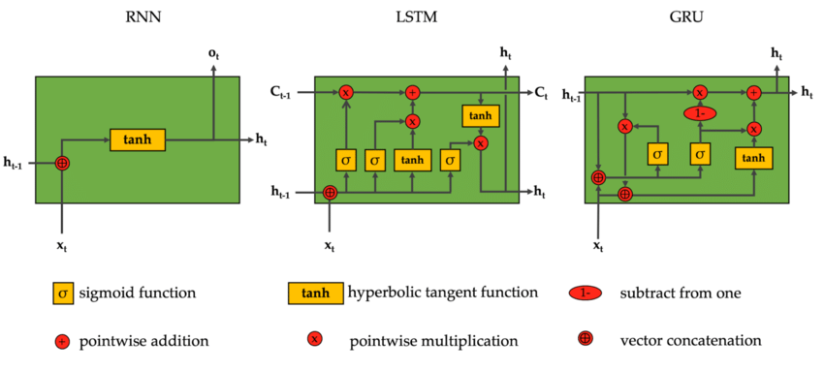
LSTM
LSTM (Long Short-Term Memory) is a type of Recurrent Neural Network (RNN) architecture designed to address the limitations of traditional RNNs.
It introduces memory cells that can store information for longer periods and gates that control the flow of information in the network.
LSTMs are widely used in tasks such as time series forecasting, speech recognition, language translation, and text generation.
Comparison of RNN and LSTM

Slide 4
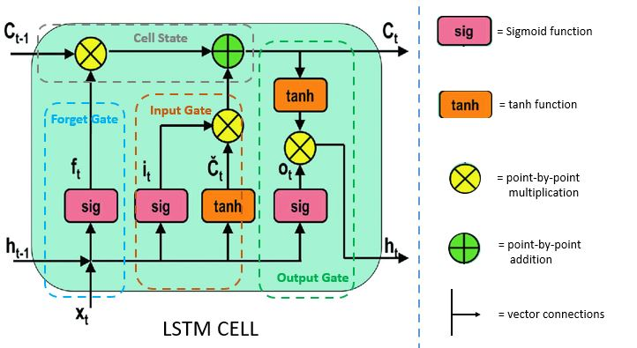
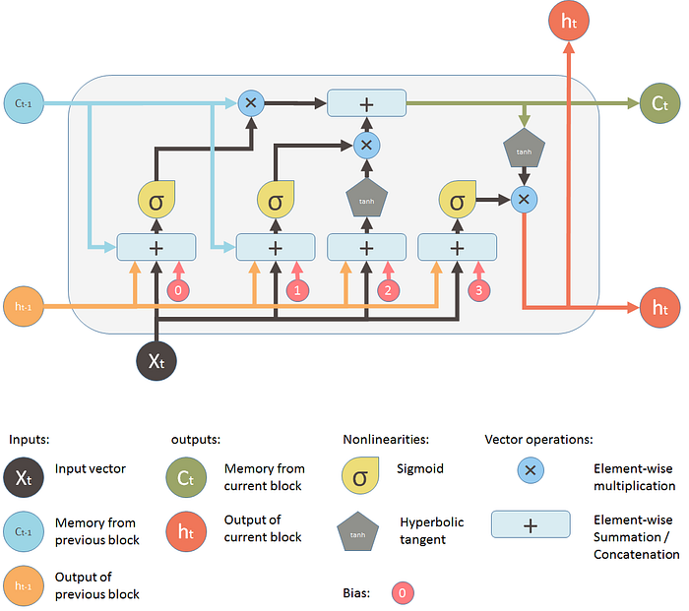
Architecture of LSTM:
Diagram of an LSTM cell highlighting key components

Slide 5
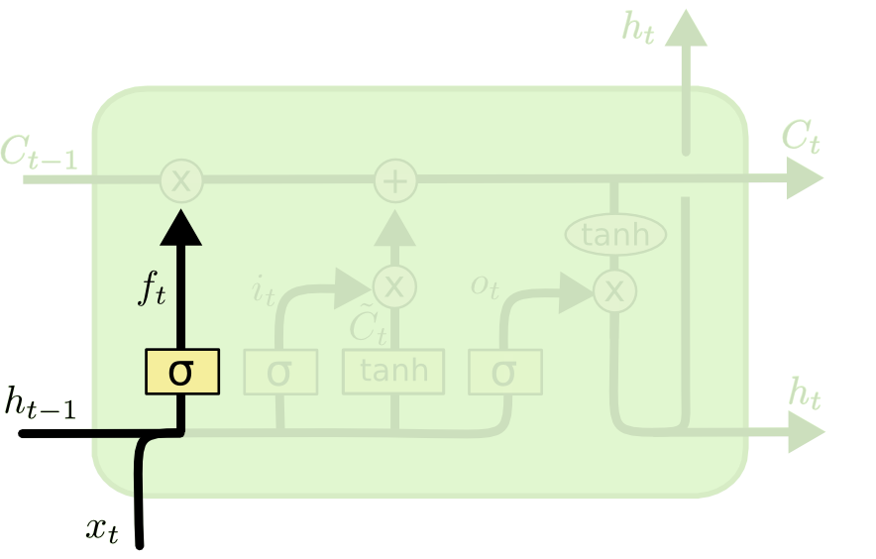
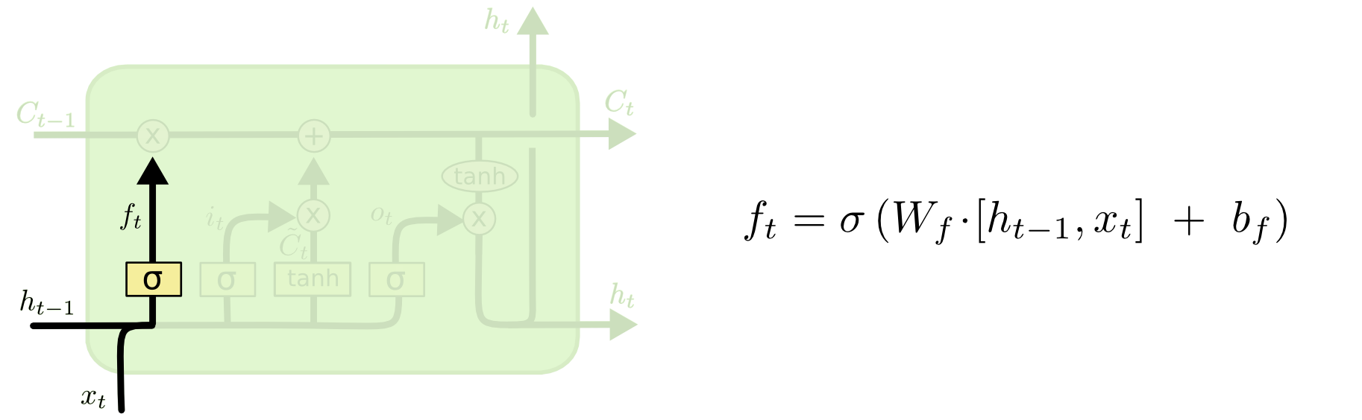
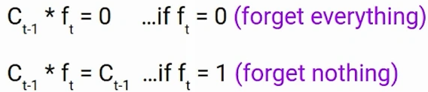
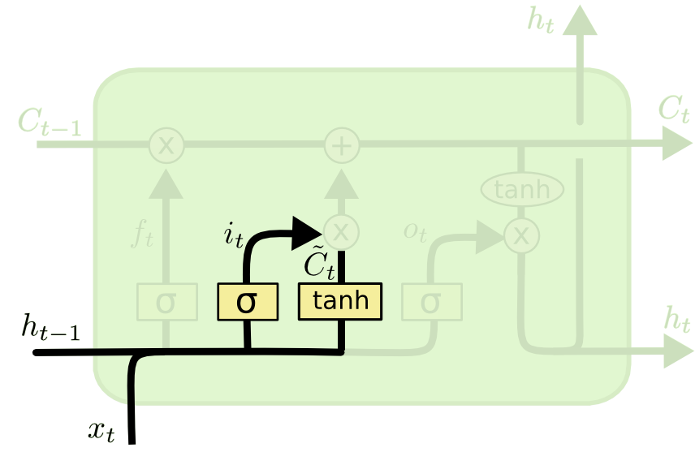
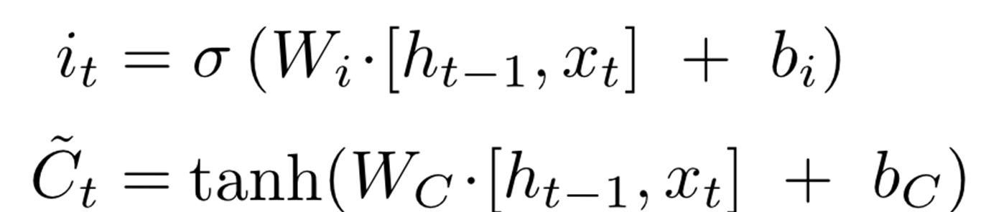
HOW LSTM WORKS
LSTM has a chain-like structure made up of memory blocks, called cells, and four neural network layers.
Forget Gate
The information that is no longer useful in the cell state is removed with the forget gate. Two inputs x_{t} (input at the particular time) and h_{t-1} (previous cell output)
Input Gate:
It decides what new information to add to the memory
Data Flowing in Forget gate
Data Flowing in Input gate

Slide 6
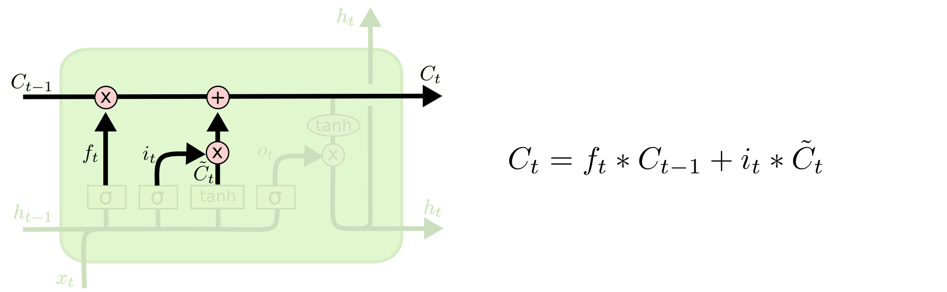
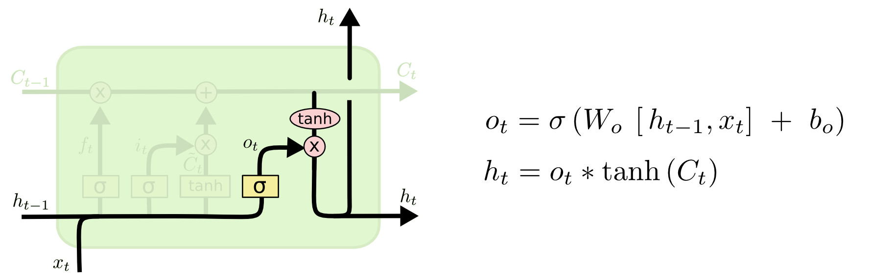
Update Cell State:
Combine the forget and input gates to update the cell state:
Output gate:
The output gate decides what the next hidden state ht​ (the output for the current time step) should be, based on the updated cell state.
New information added to cell state
Output gate

Slide 7
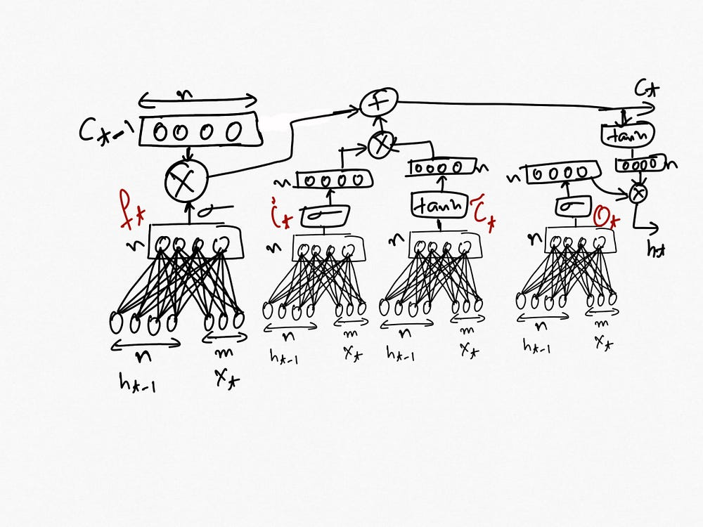
LSTM Cell Architecture: A Deep Flow of Gates and Memory Updates

Slide 8
Flowing information through different gates

Slide 9


